Slide 1



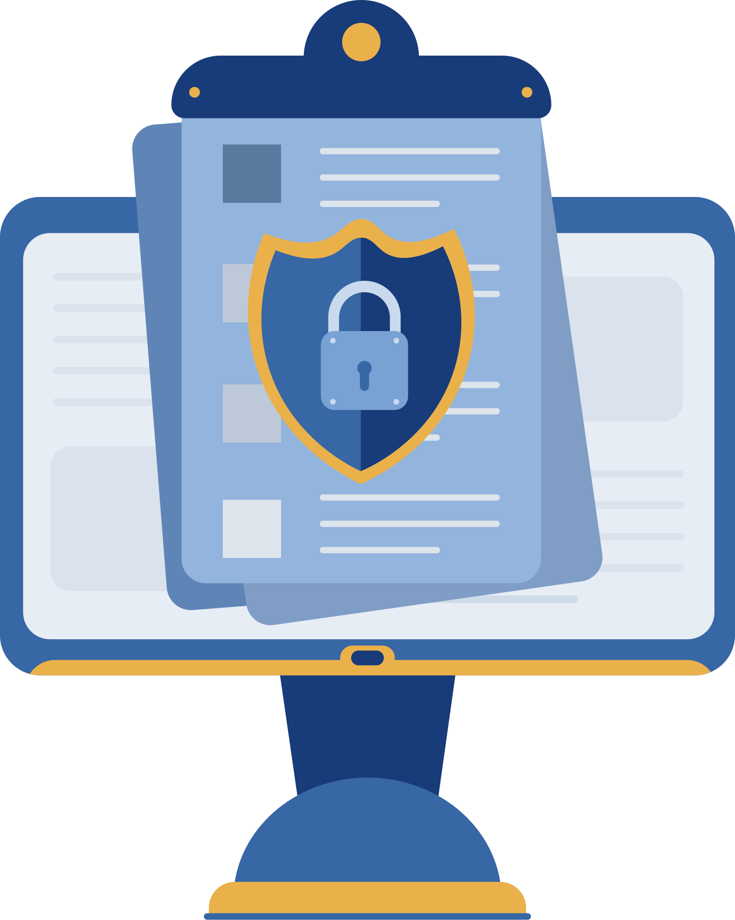

PHISHING ATTACKS
BY: Hanna Sarah Paul

Slide 2

What is Phishing ?
Purpose: Give an overview of phishing and why it matters.
Content:
Definition: Phishing is a cyber attack where attackers trick individuals into revealing sensitive information by pretending to be trustworthy sources.
Why it’s dangerous: Identity theft, financial loss, data breaches.
Common platforms: Email, SMS, social media, fake websites.

Slide 3
Types of Phishing
Type of Phishing | Description | Delivery Method | Target Audience | Example
Email Phishing | Generic phishing messages sent to many users. Often includes malicious links or attachments. | Email | General public or employees | “Your account has been compromised. Click here to secure it.”
Spear Phishing | Customized, targeted email sent to a specific individual using personal information. | Email | Specific individuals (e.g., employees, managers) | Email appearing to come from HR asking to update payroll info.
Whaling | A form of spear phishing aimed at top executives or high-level personnel. | Email or phone | Executives (CEO, CFO, etc.) | Fake legal request targeting a CEO to authorize a wire transfer.
Smishing | Phishing using SMS/text messages to trick users into clicking malicious links. | SMS/Text Message | Smartphone users | “Your parcel is waiting. Track delivery here: bit.ly/XYZ.”
Vishing | Voice phishing where attackers call pretending to be from a legitimate source. | Phone call | Individuals or businesses | “This is your bank. We need to verify suspicious activity on your account.”
Pharming | Redirects users to fake websites even when a correct URL is typed in. | DNS poisoning or malware | Any internet user | User types “www.bank.com” but is redirected to a fake site that looks identical.

Slide 4
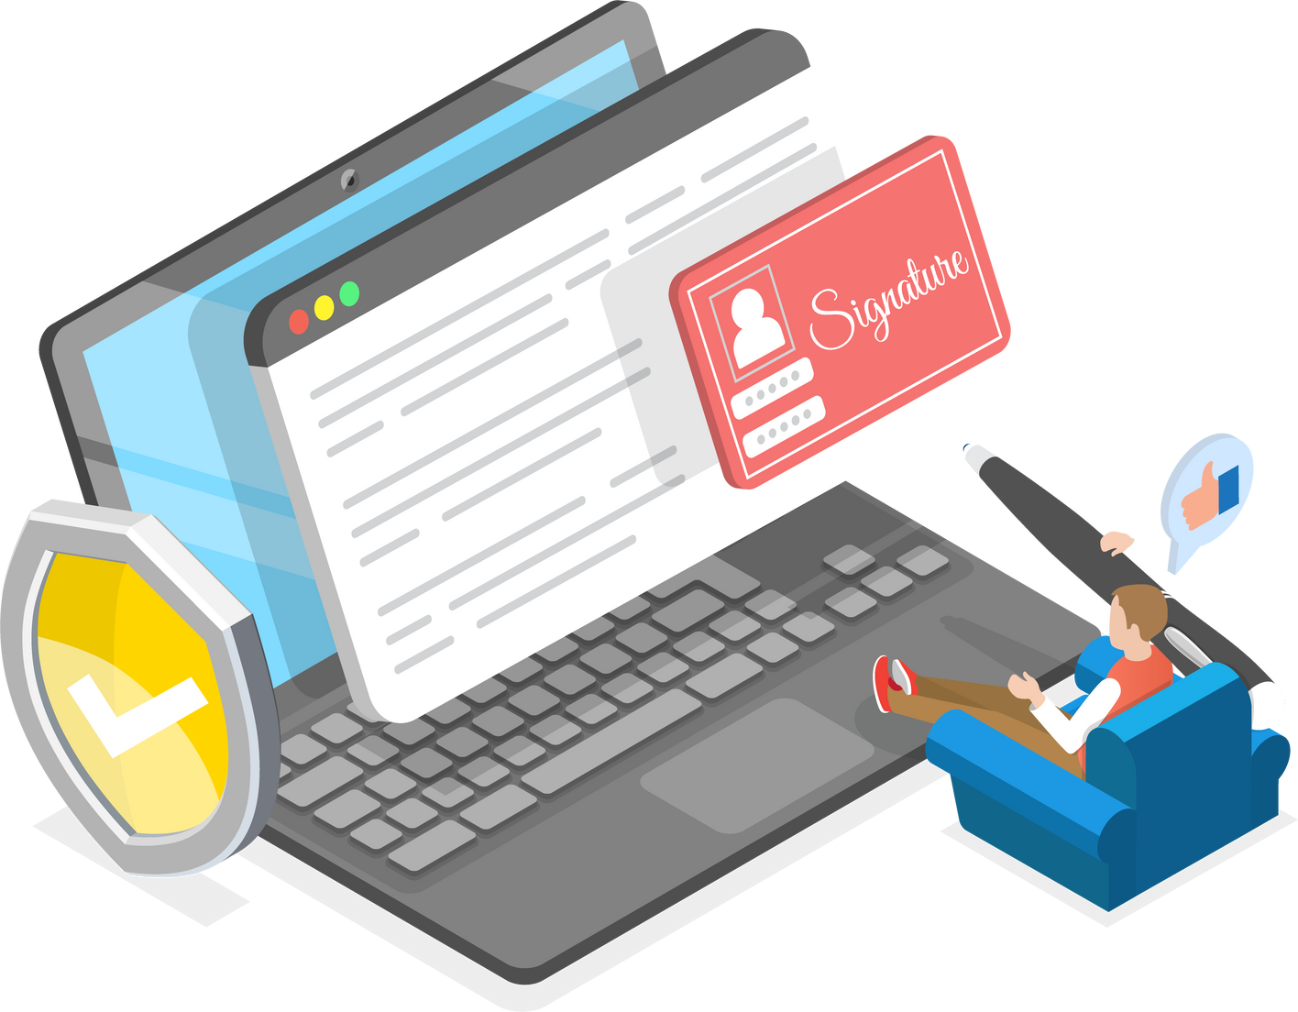
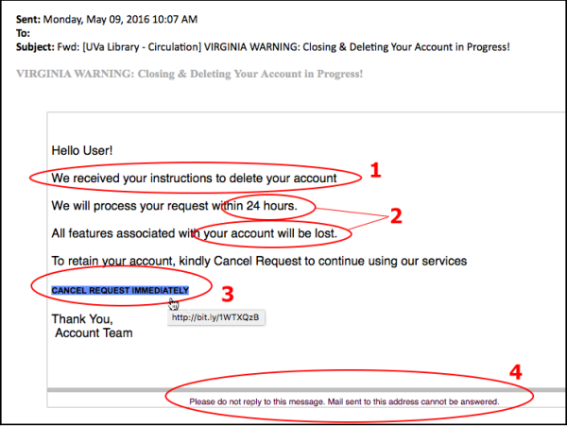
How to Recognize a Phishing Email???
Red Flags in Emails:
Sender address is unusual (e.g., security@amaz0n.com).
Poor spelling or grammar.
Urgent call to action: “Act now or your account will be locked!”
Generic greeting: “Dear Customer” instead of your name.
Unexpected attachments or links.
Hovering over a link shows a different (suspicious) destination.
Real-World Example:
A 2021 phishing campaign mimicked Microsoft Teams login pages to steal work credentials from remote workers.

Slide 5
Social Engineering Tactics Used in Phishing
Common Psychological Tricks:
Urgency and Fear: “You must act now or your account will be closed.”
Authority Figures: Attackers impersonate managers, IT staff, or government officials.
Greed: Offers like fake refunds, job offers, or lottery winnings.
Curiosity: “You’ve received a document” or “Check out this funny video.”
Trust Exploitation: Use of familiar names, brands, or previous conversations.
Real Example:
A scammer poses as the CEO and asks the finance department to urgently transfer funds to a “vendor.”

Slide 6

Best Practices to Avoid Falling Victim
For Emails and Messages:
Don’t click suspicious links or attachments.
Always verify with the sender through another channel.
Avoid responding to messages asking for personal information.
For Websites:
Always type the URL manually or use trusted bookmarks.
Check for security certificates (padlock icon).
Technical Safeguards:
Enable Multi-Factor Authentication (MFA).
Keep browsers, operating systems, and antivirus updated.
Use anti-phishing browser extensions.
.

Slide 7
Real-World Phishing Incidents
Sony Pictures Hack (2014):
Started with phishing emails to employees.
Led to massive data breaches and movie leaks.
Google & Facebook (2013–2015):
Lost $100M+ to a Lithuanian attacker impersonating a hardware supplier via phishing emails.
Twitter Hack (2020):
Social engineering + phishing gained access to admin tools.
Used to hack celebrity accounts like Elon Musk and Barack Obama

Slide 8
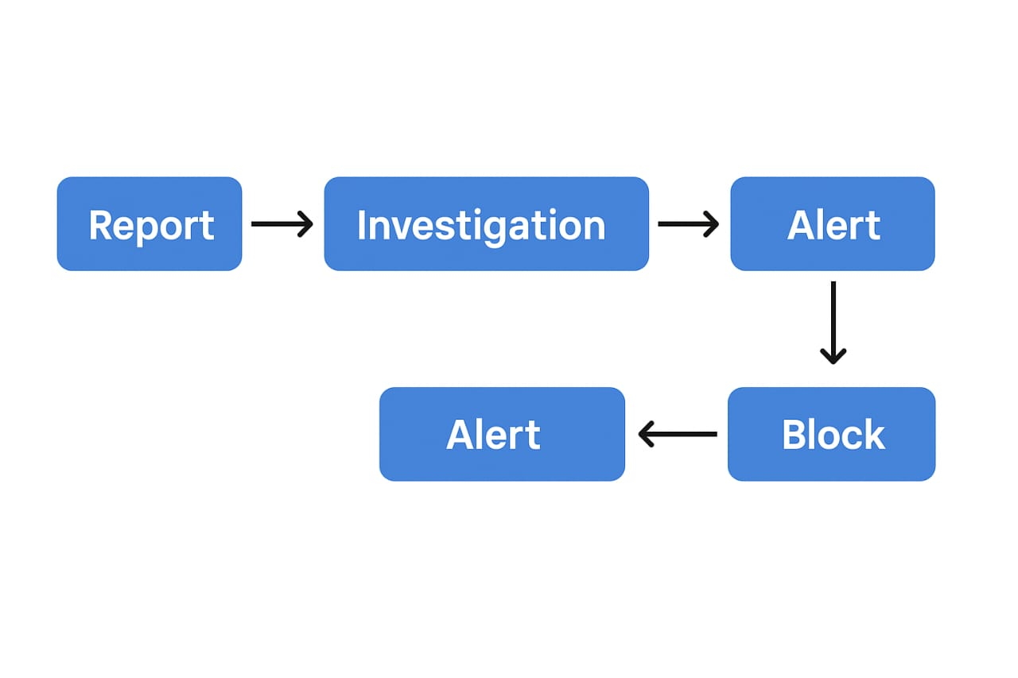
How Organizations Can Defend Themselves??
Employee Training Programs:
Simulated phishing exercises.
Periodic awareness workshops.
Policies and Tools:
Email filtering tools (e.g., Proofpoint, Mimecast).
Incident reporting systems.
Role-based access controls.
Culture of Security:
Encourage employees to ask and verify.
No blame for reporting suspicious content.

Slide 9
How Organizations Can Defend Themselves??
4. You receive a message saying, “Your account will be locked in 24 hours unless you verify now.” What is this an example of?
A. Malware
✅ B. Social engineering through urgency
C. Routine alert
D. Technical update
5. How can you check if a hyperlink in an email is suspicious?
A. Double-click it
✅ B. Hover over it without clicking to view the actual URL
C. Copy-paste it in your browser
D. Forward it to a colleague
6. What is “spear phishing”?
A. A phishing attempt via SMS
B. Mass phishing emails to thousands of users
✅ C. A targeted phishing email crafted for a specific individual
D. A phishing attack using phone calls
7. Which of the following is NOT a safe practice?
✅ A. Logging into your bank account through a link in an email
B. Enabling multi-factor authentication (MFA)
C. Keeping your software up to date
D. Reporting phishing attempts
1. What is a common sign of a phishing email?
A. A professional-looking logo
B. An offer from a known brand
✅ C. A sense of urgency and suspicious links
D. A PDF attachment
2. Which of the following is the best action if you receive a suspicious email?
A. Forward it to your friend
B. Click the link to see what happens
✅ C. Report it to your IT/security team
D. Delete it without telling anyone
3. What emotion is most commonly exploited in phishing emails?
A. Confidence
✅ B. Fear
C. Curiosity
D. Excitement

Slide 10
Conclusion
Phishing is a growing and evolving threat.
Stay vigilant. Think before you click.
Verify everything. Trust no one by default.
Report suspicious content immediately.
Final Tips Checklist:
✔ Use MFA
✔ Educate yourself regularly
✔ Check URLs
✔ Don't overshare on social media

